Slide 1










Project Stardust
Isai Patena Ortiz
Alexandria Hayes
William Gyrulf
Joshua Ryder
Michael Plummer
Robert Brewington
Alex Aguilar
Denise Ryder
Dr. Armineh
Noravian
Dr. DEMETRA
SKALTSAS

Slide 2
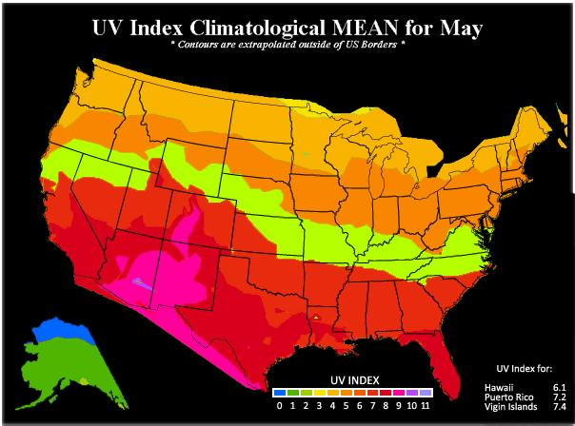
Research Question (Denise)
Question: Which atmospheric factors might lead to Arizona being hotter than other similar locations?
Arizona is significantly hotter than other locations at similar latitudes with desert climates. Could this possibly be due to:
Higher levels of UV at our stratospheric location relative to other locations, resulting directly in increased UV at ground level.
Lower levels of ozone in the stratosphere would lead to higher levels of UV at ground level.
Similar to the ozone case, lack of water vapor in the atmosphere due to desert conditions could also lead to higher levels of UV at ground level.

Slide 3
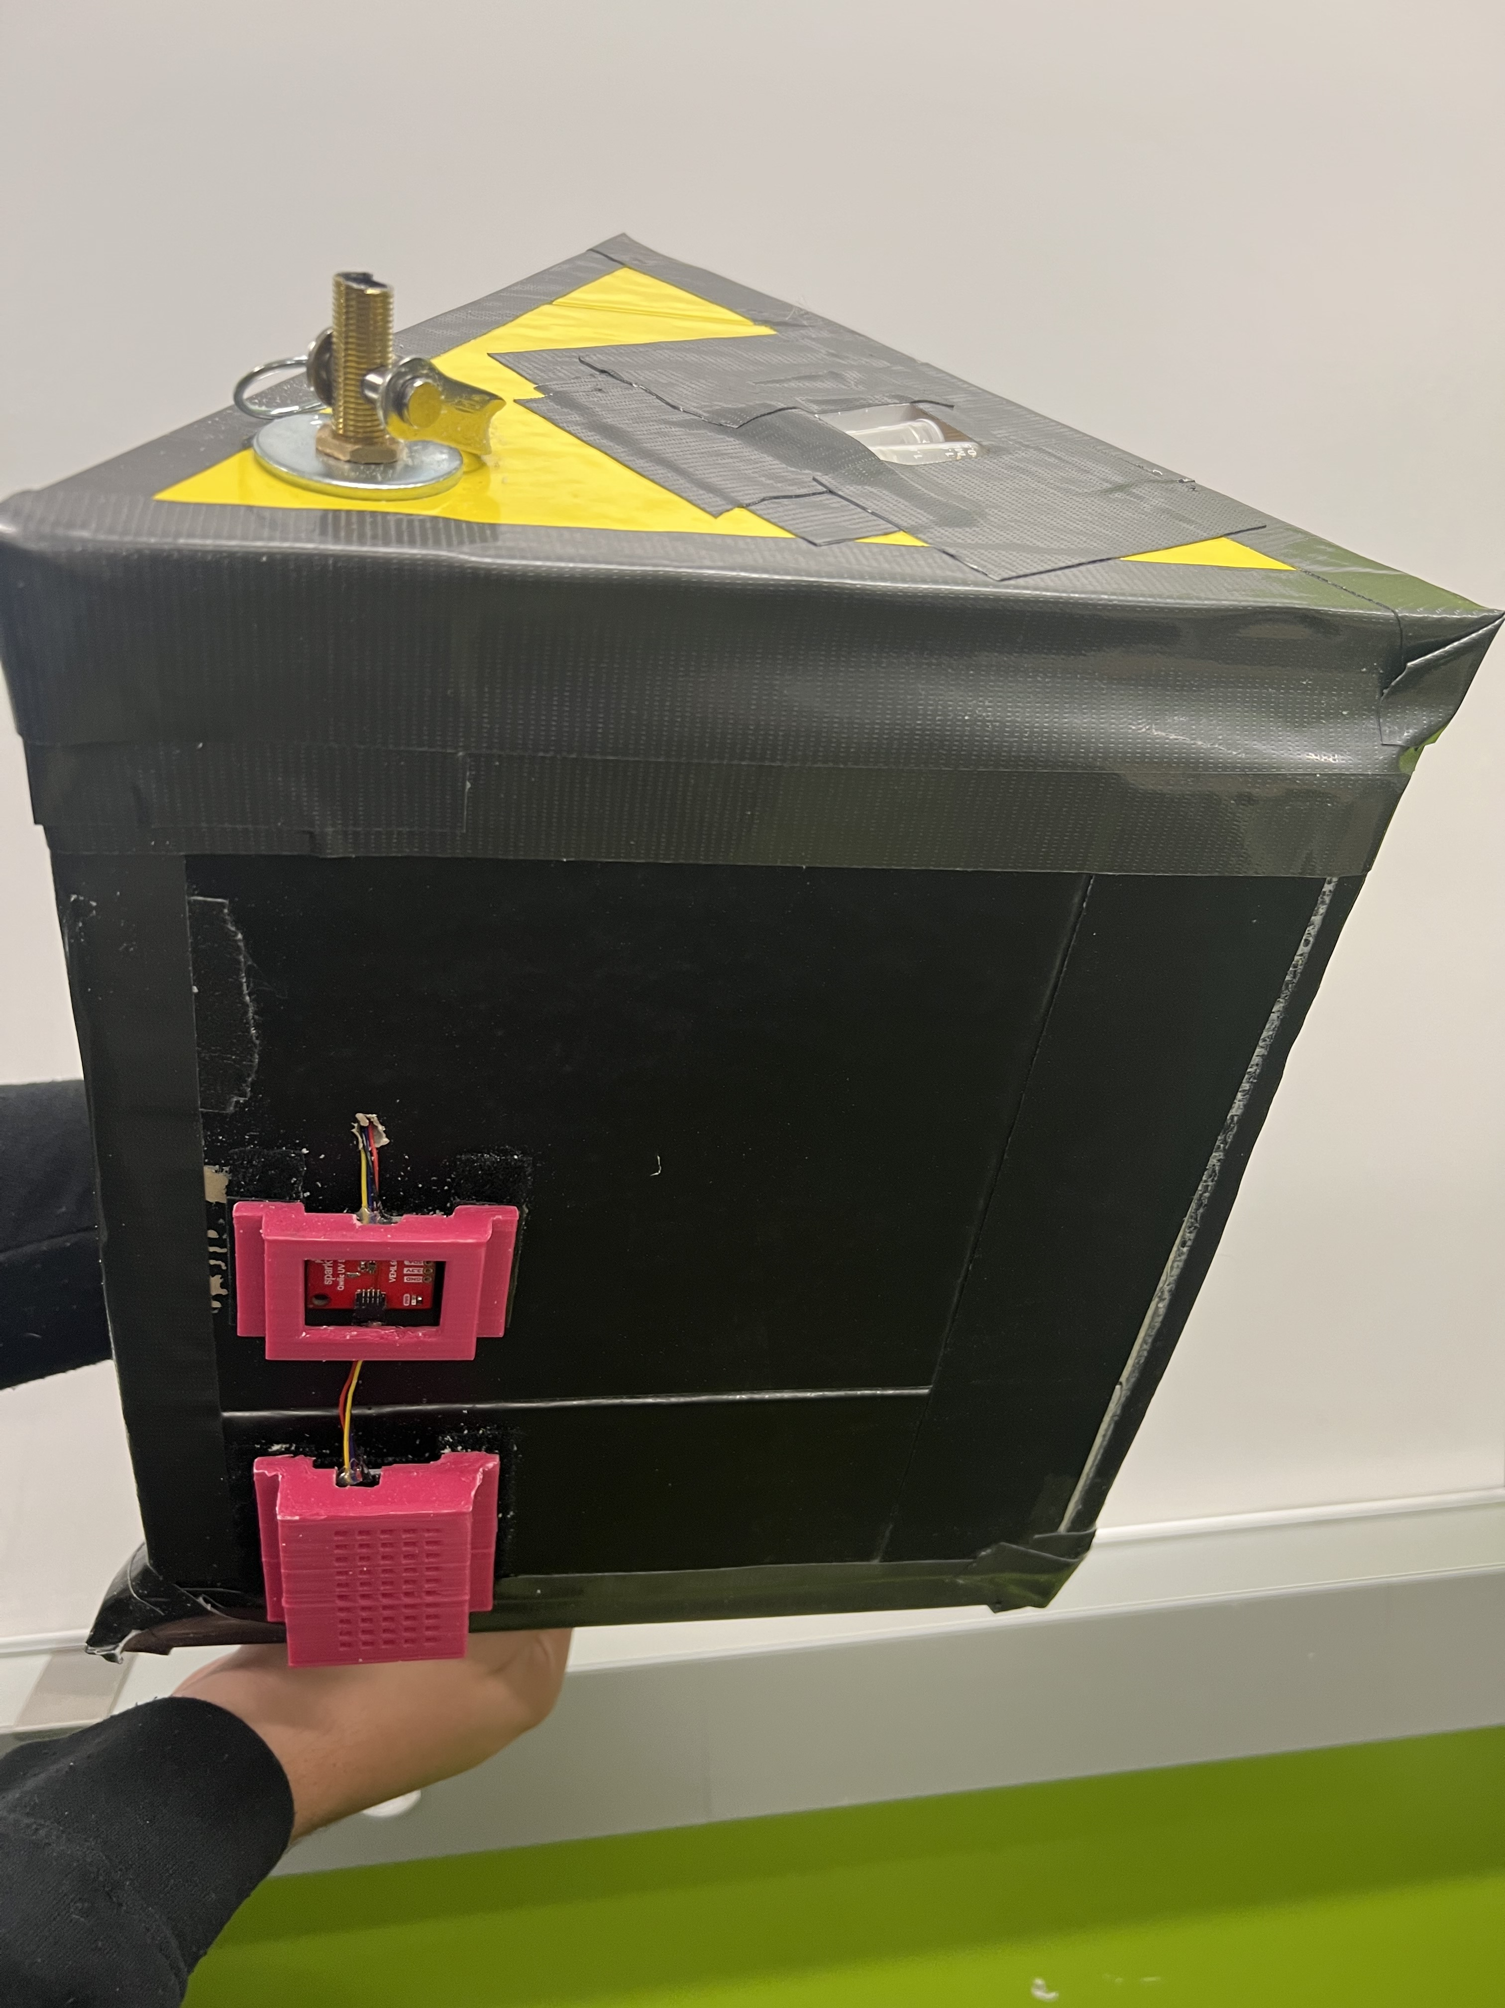
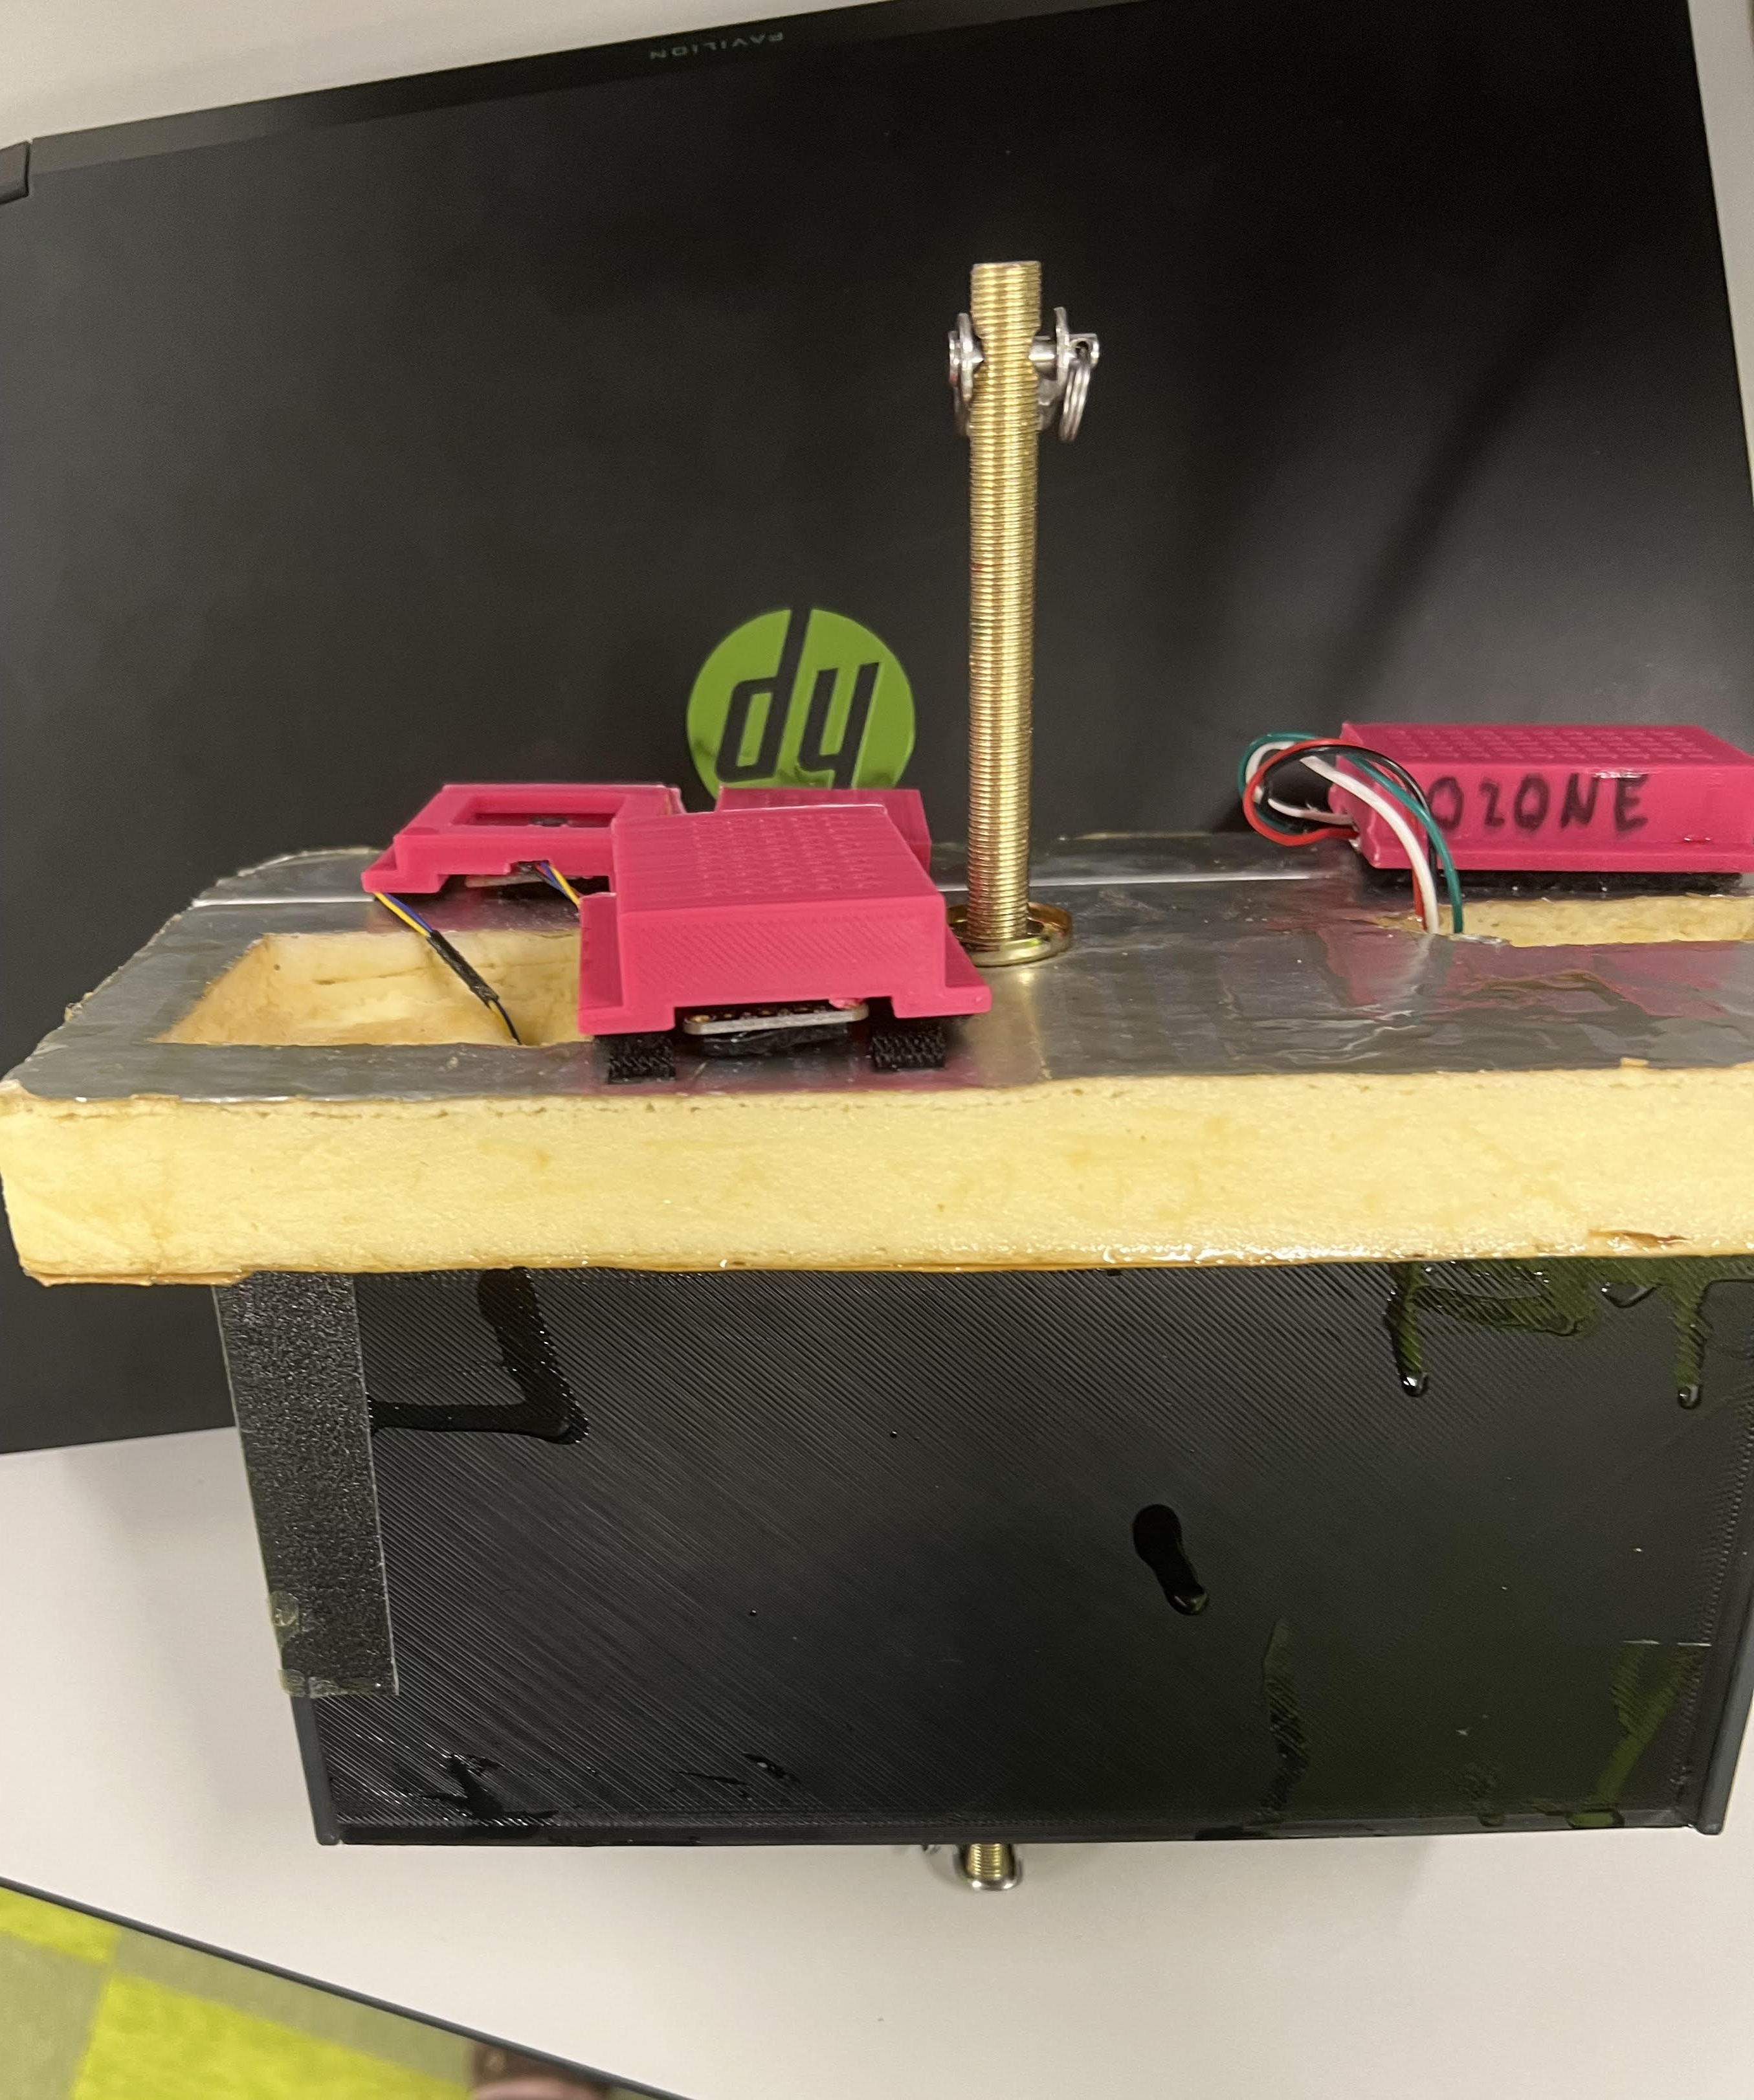
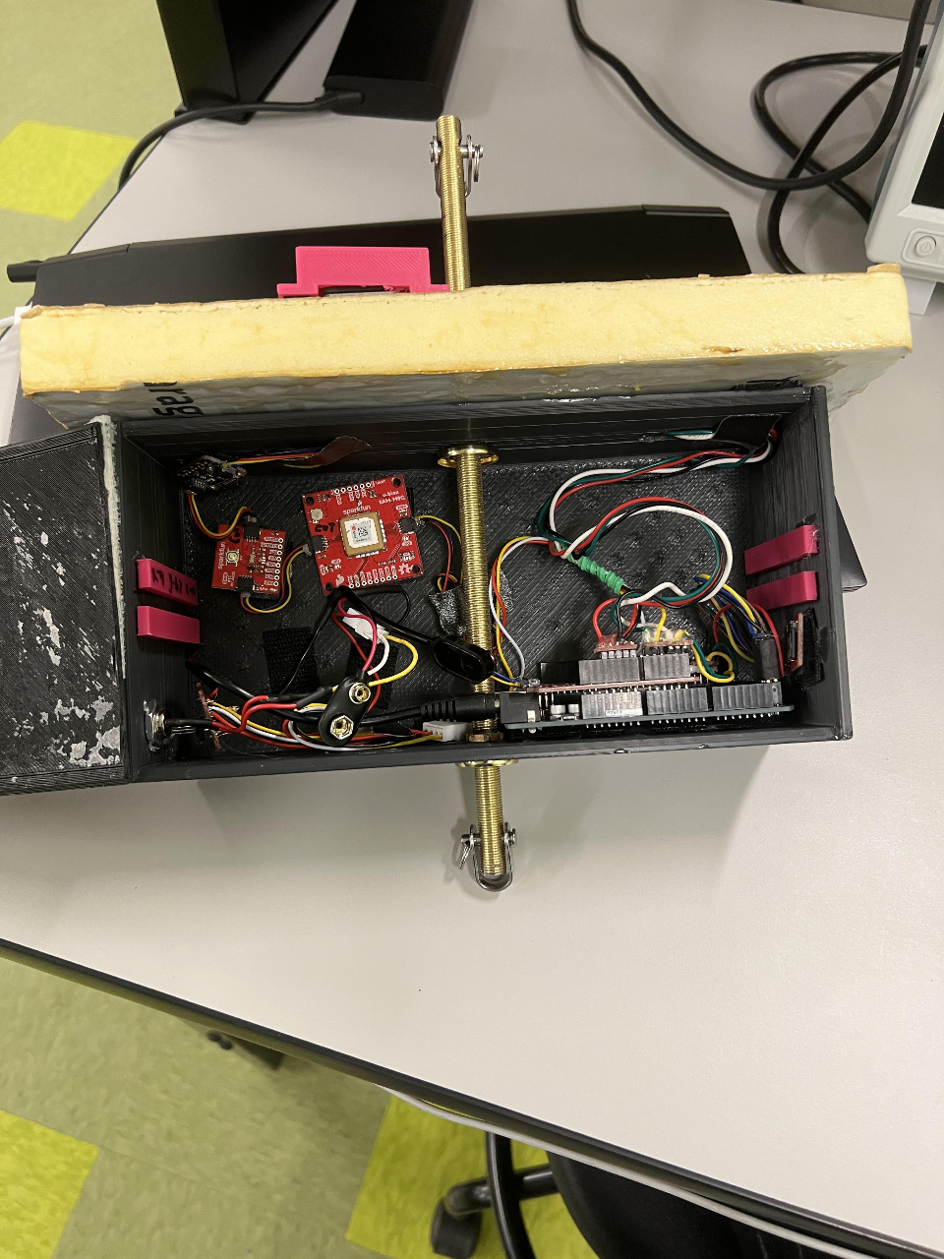
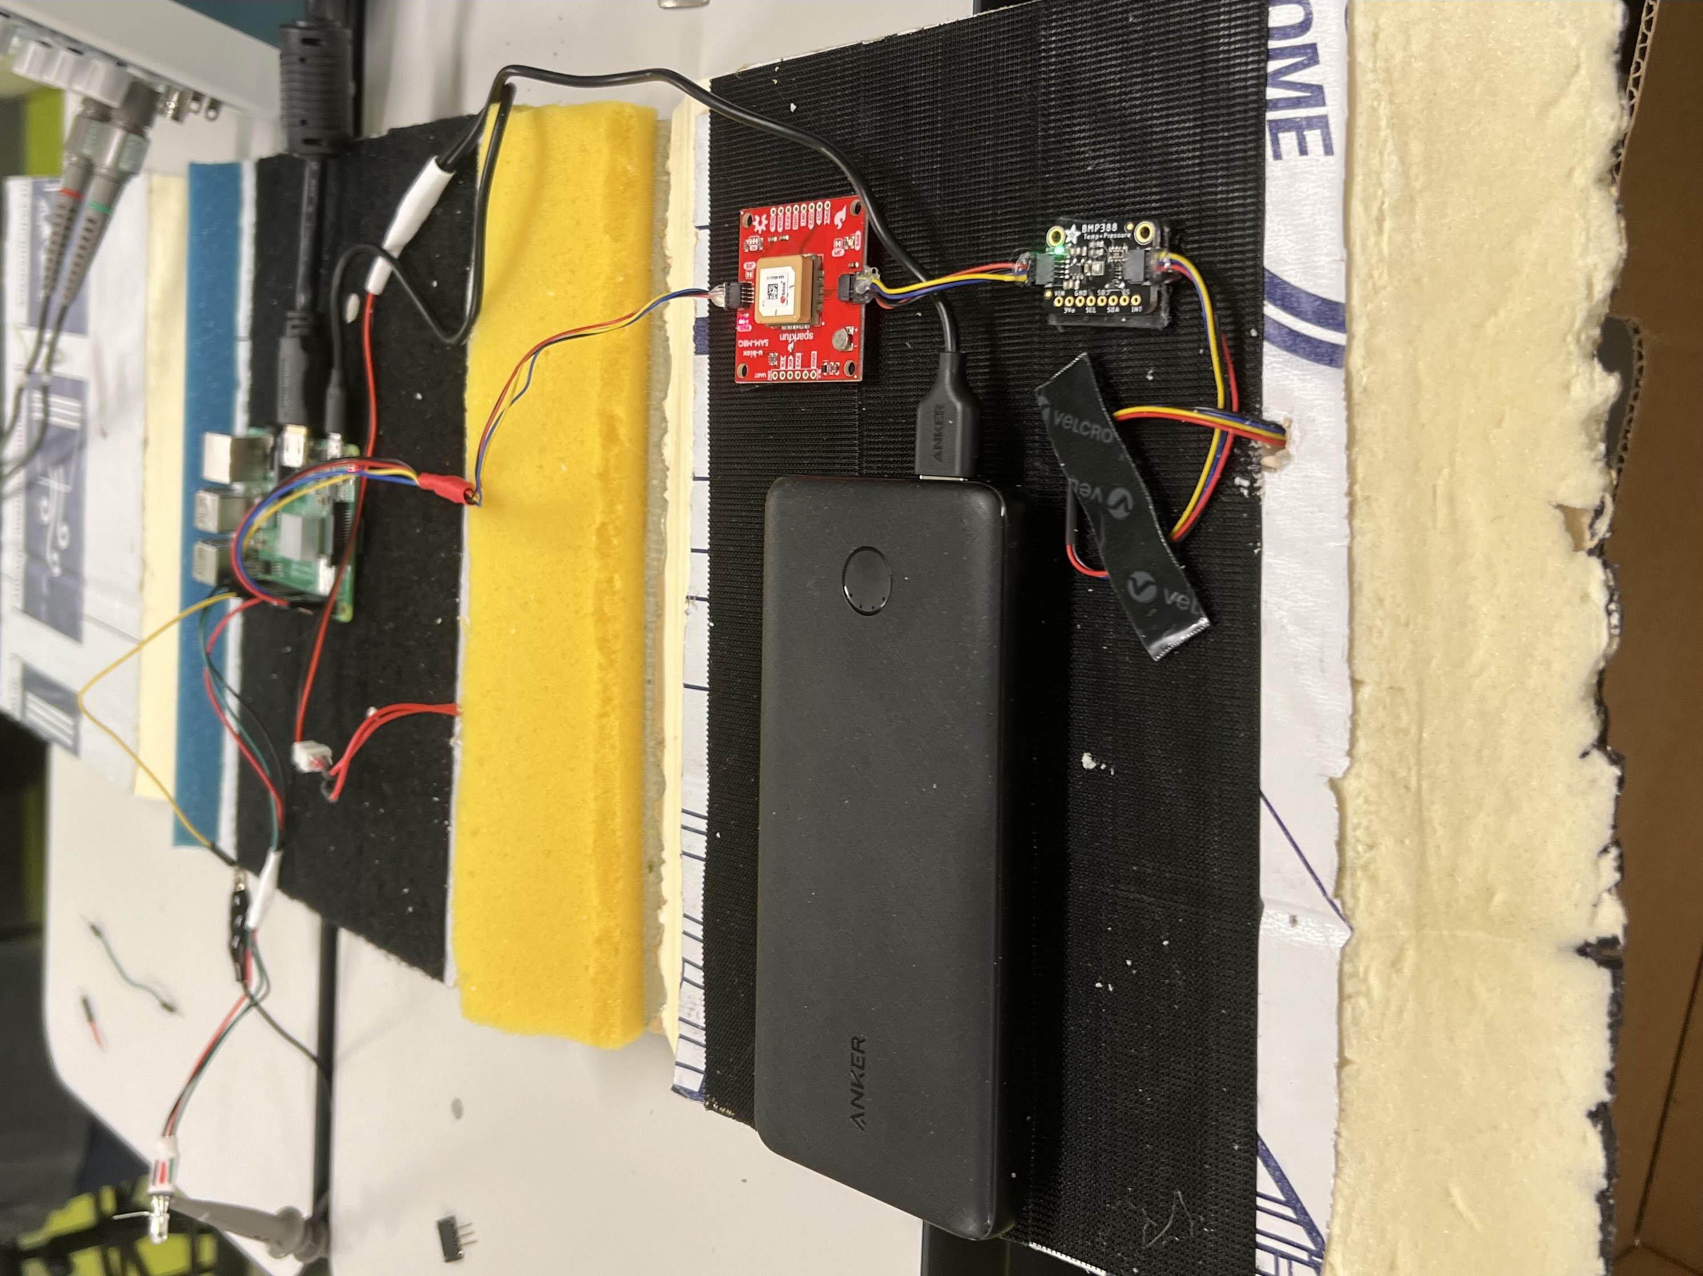
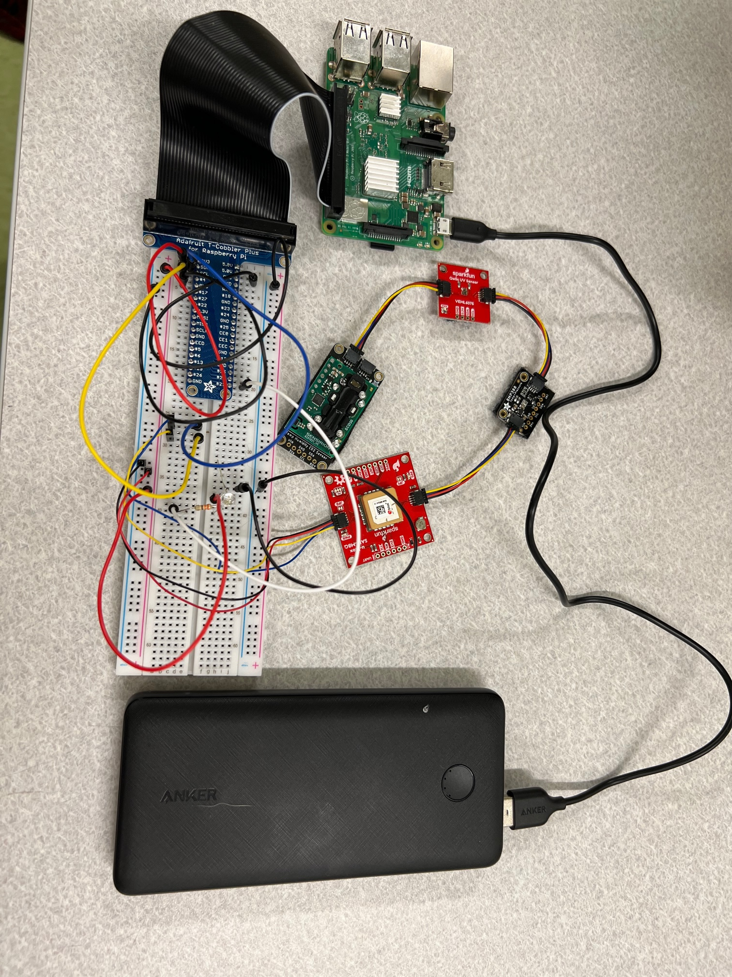
Two Payloads With Separate Systems (Alexandria)
Alexandria
Foam Payload Enclosure
1" Insulated foam
882g = 1.94 lbs
Raspberry Pi
3D Payload Enclosure
Printed out of PLA
Smaller 749g = 1.65 lbs
Arduino based

Slide 4
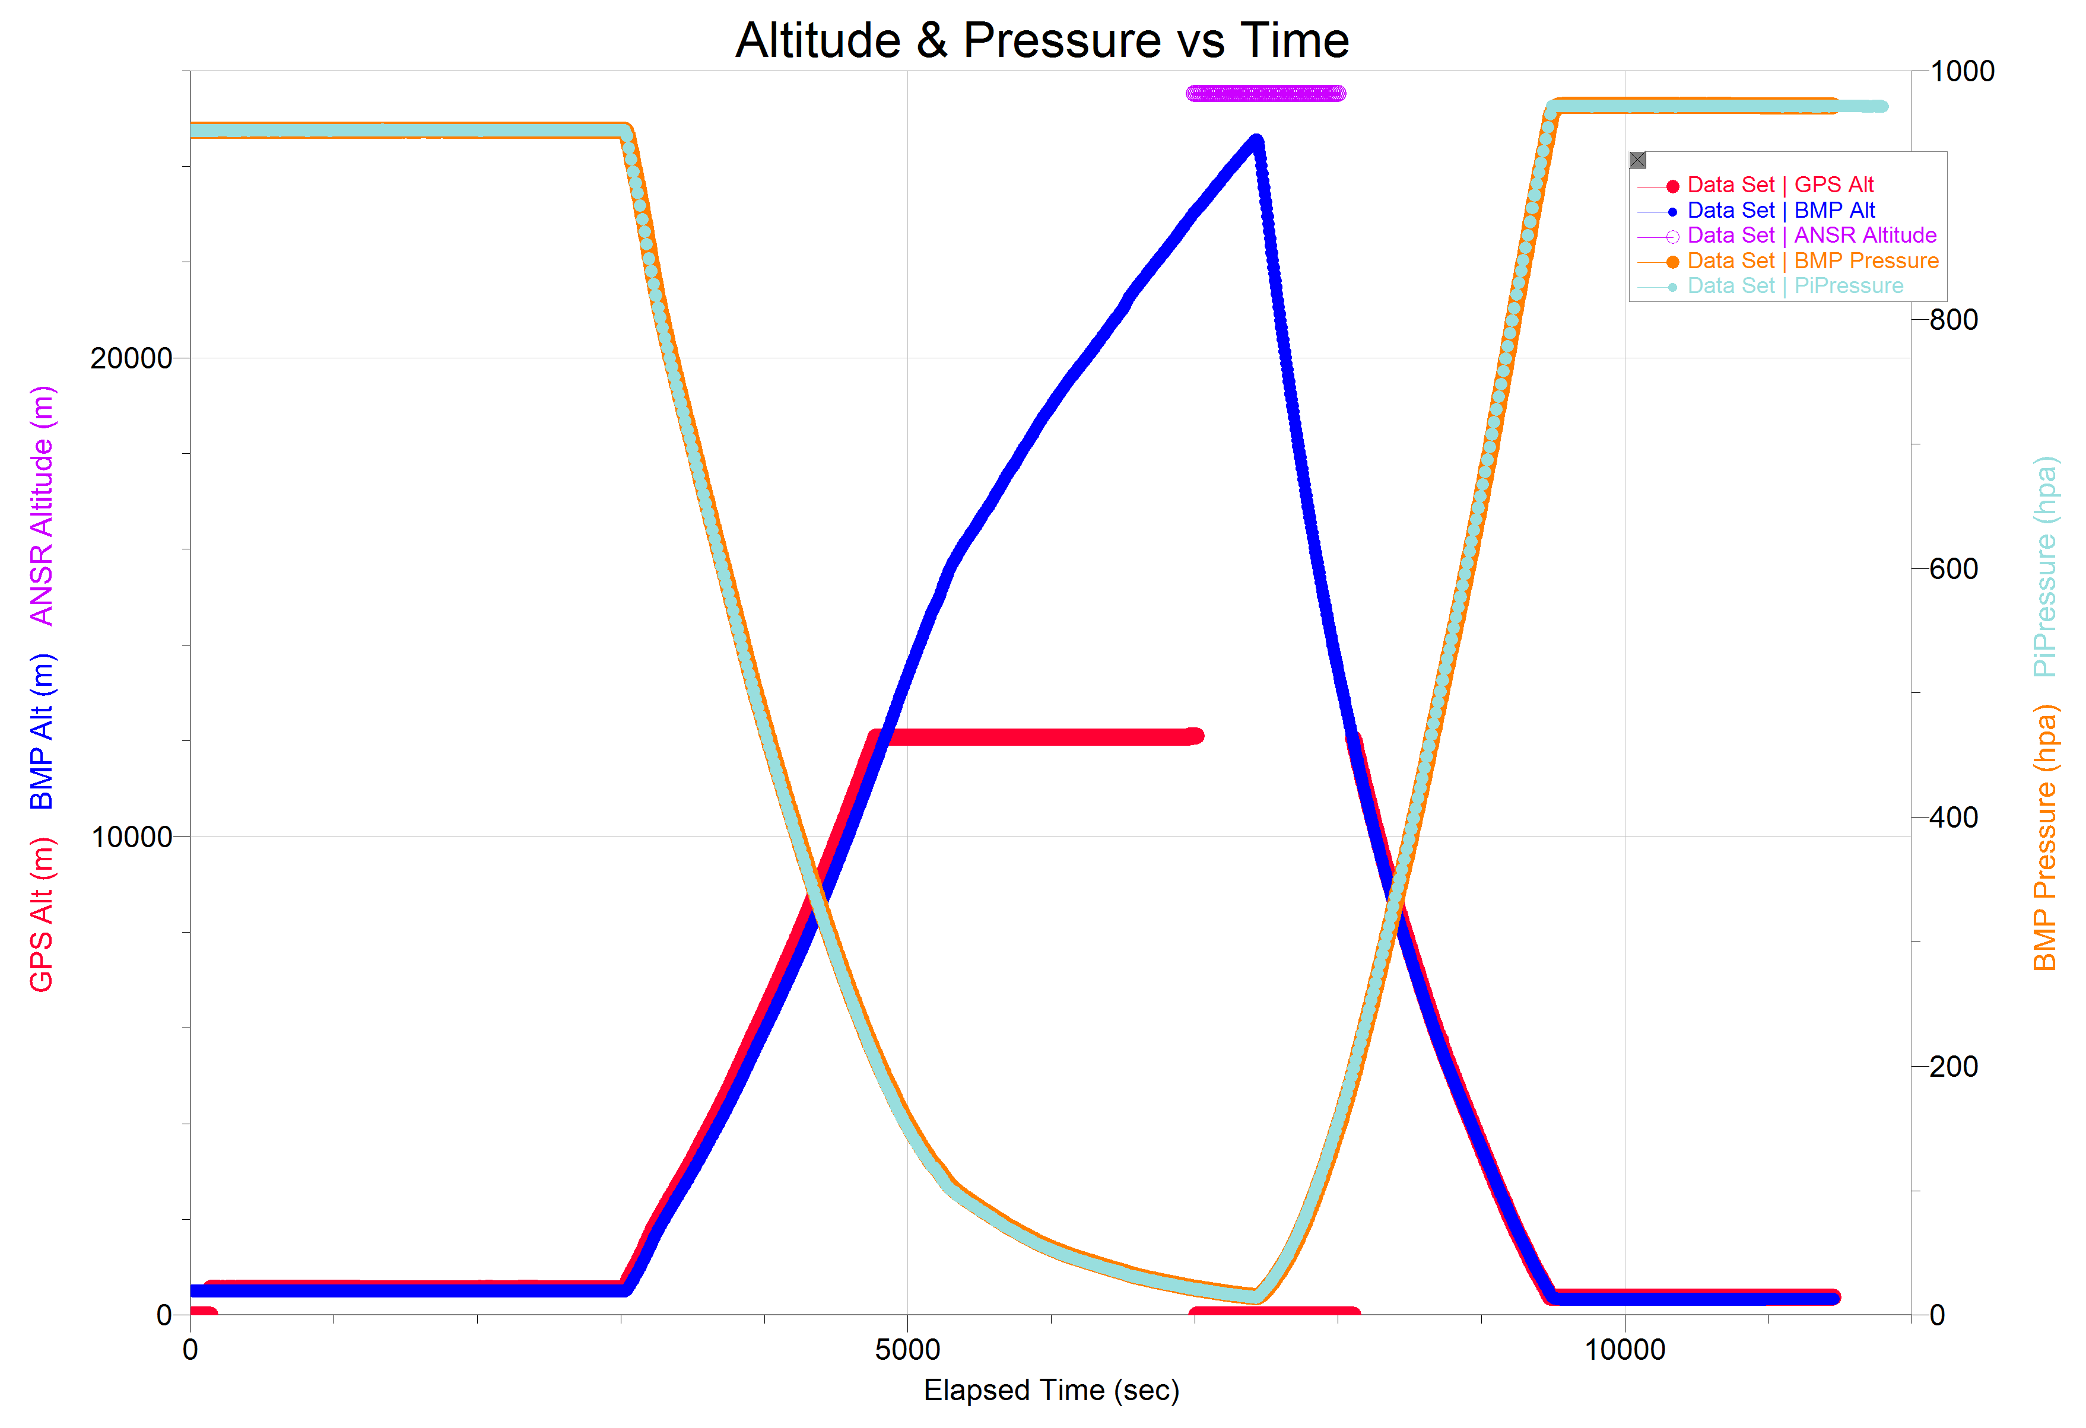
Arduino: Altitude & Pressure (Alex)
Reached 24,500 m, 80,000 ft.
Arduino & Pi Pressure identical
ANSR data max is 25515 m
Sparkfun SAM-8Q GPS (Red) maxed out at 12,000 m (spec is 50,000 m). Lost fix shortly before burst, re-aquired when balloon reached 12,000 m again.
This is the cold temperature region
Ascent slowed around 16,000 meters.

Slide 5
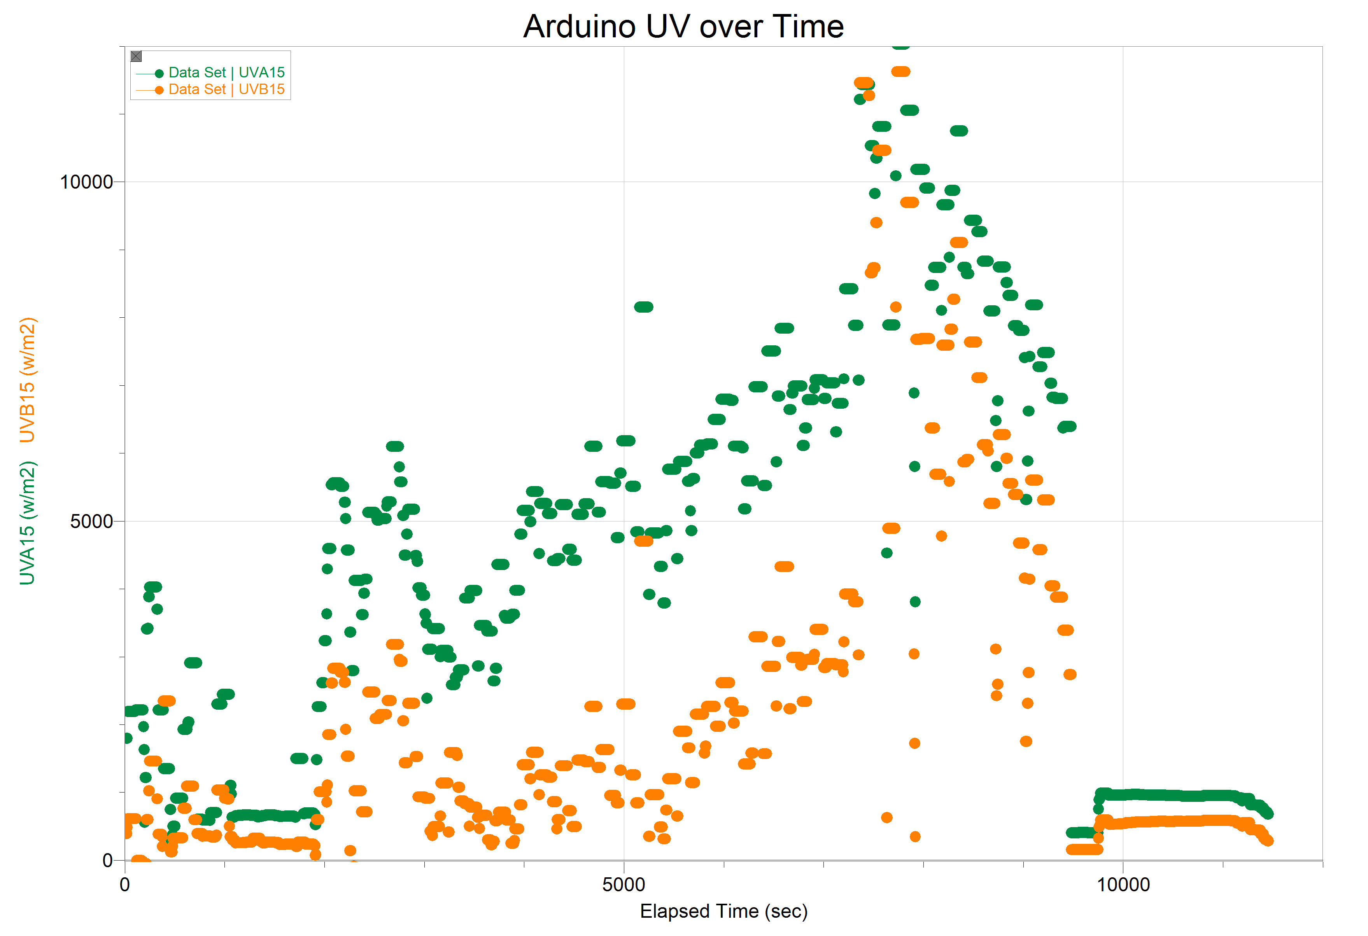
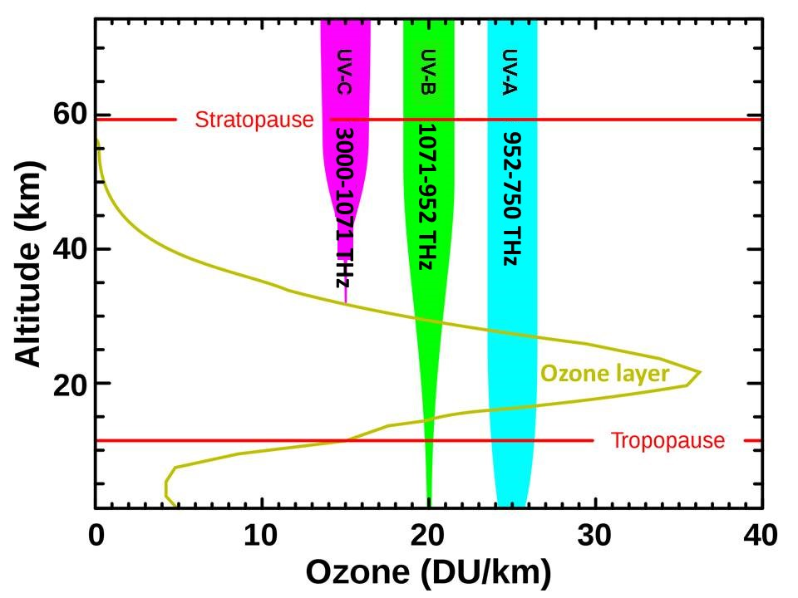
Arduino: UVA & UVB (Michael)
Very noisy as payload spins and wobbles.
Sensitive to the incident light angle.
Pi system has reduced values; sensor was mounted on the side of the payload
Filter applied to data helps a bit.
Matches expected pattern for UV.

Slide 6
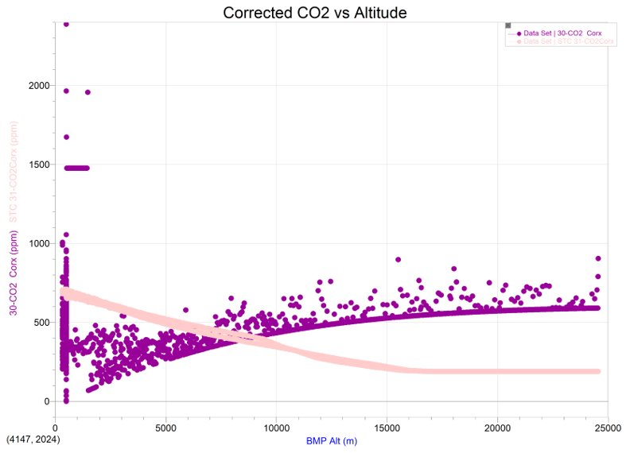
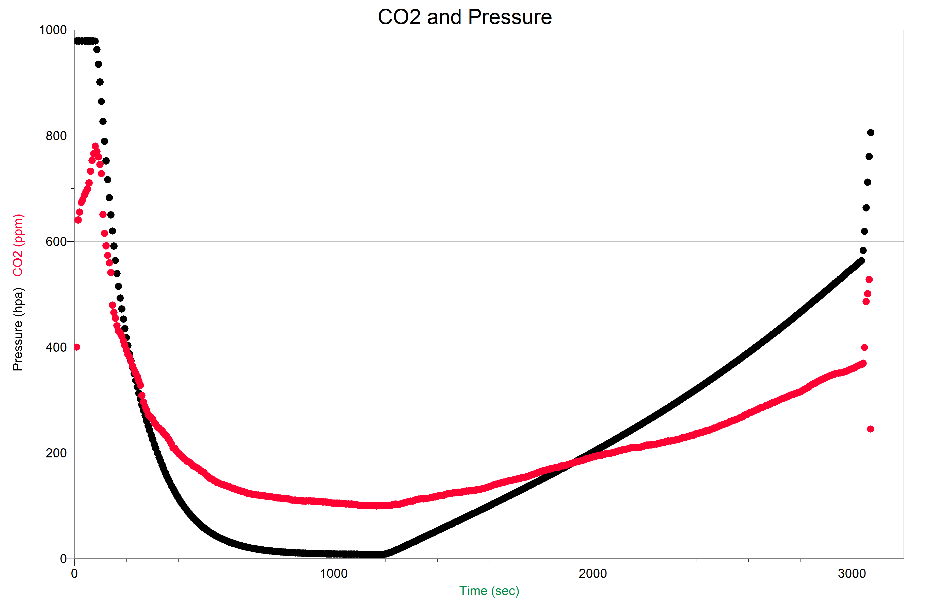


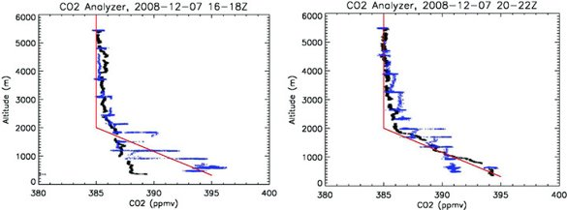
Arduino: CO₂ vs Altitude (Brew)
Brew
Question – What is measured by gas sensors?
1 atm 400 ppm
Corrections are poor.
CO₂ stays constant with altitude.
All gas sensors need correction.
0.25 atm - ?? ppm

Slide 7
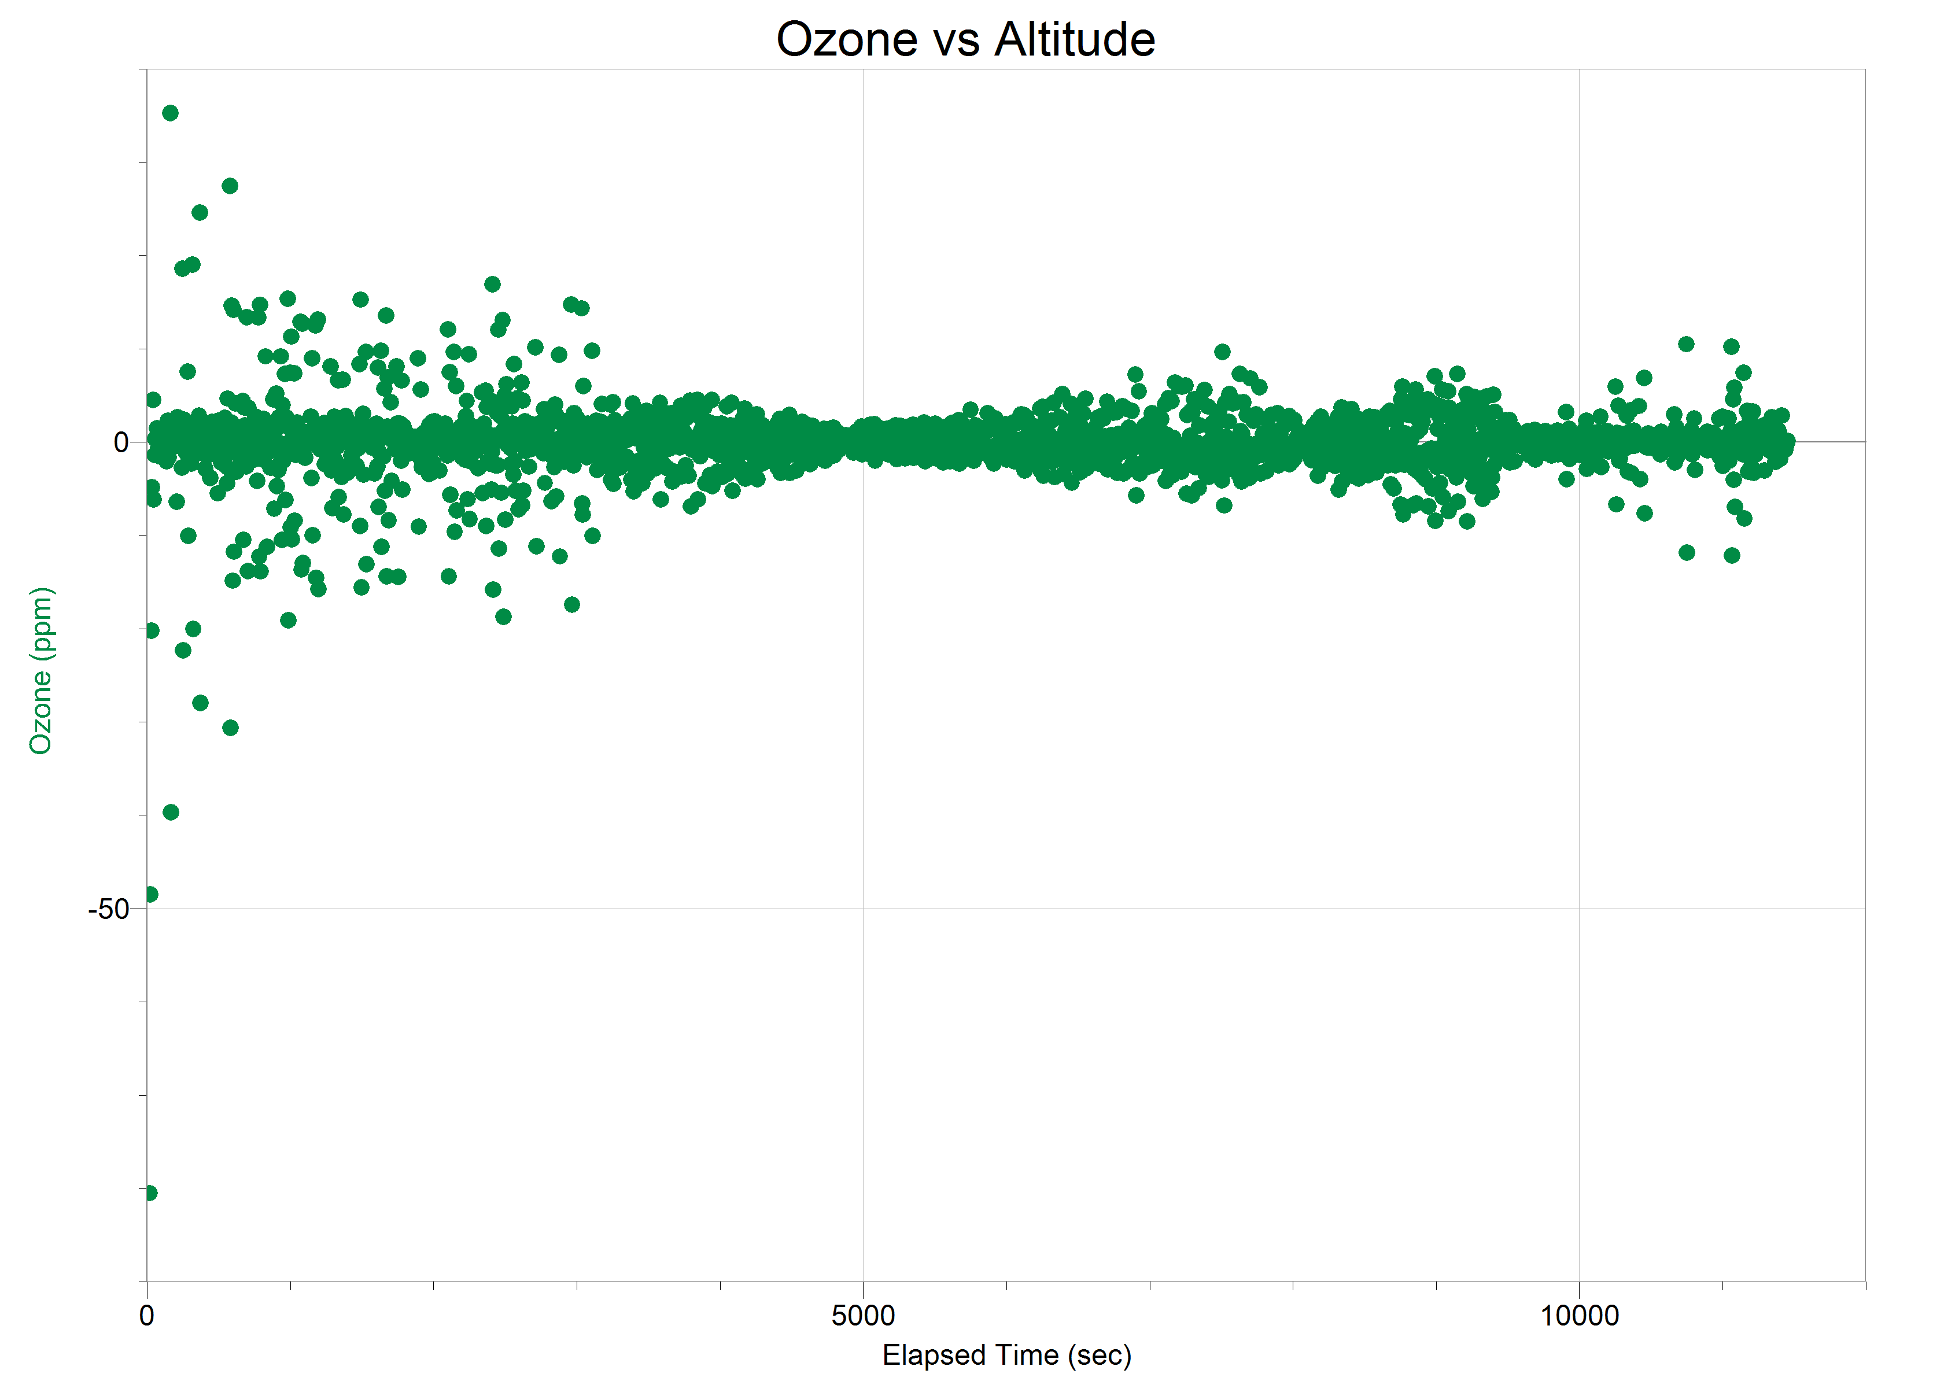
Arduino: Ozone vs Time (Brew)
Brew
Sensor did not work?
Balloon did not reach ozone layer?
We are missing ozone?

Slide 8
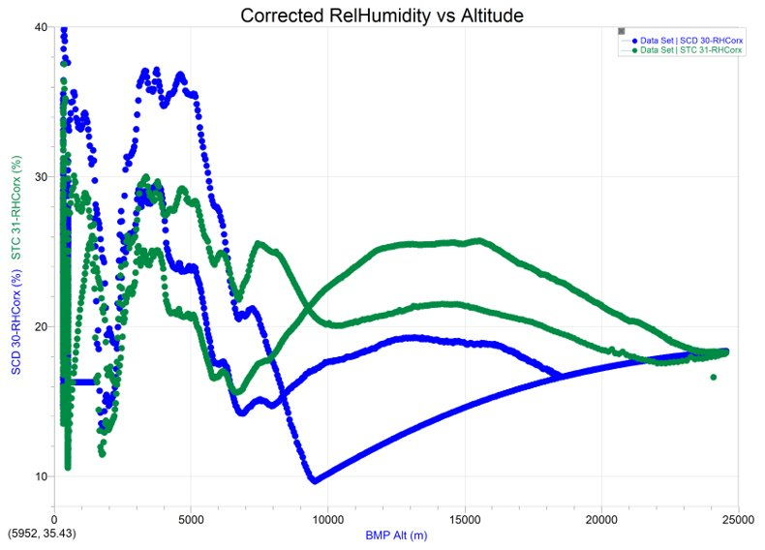
Arduino: % Relative Humidity vs Altitude (Isai)
Used 2 CO2 sensors
Large swings in values, especially at low altitudes.
Hysteresis effect – sensor needs more sampling time?

Slide 9
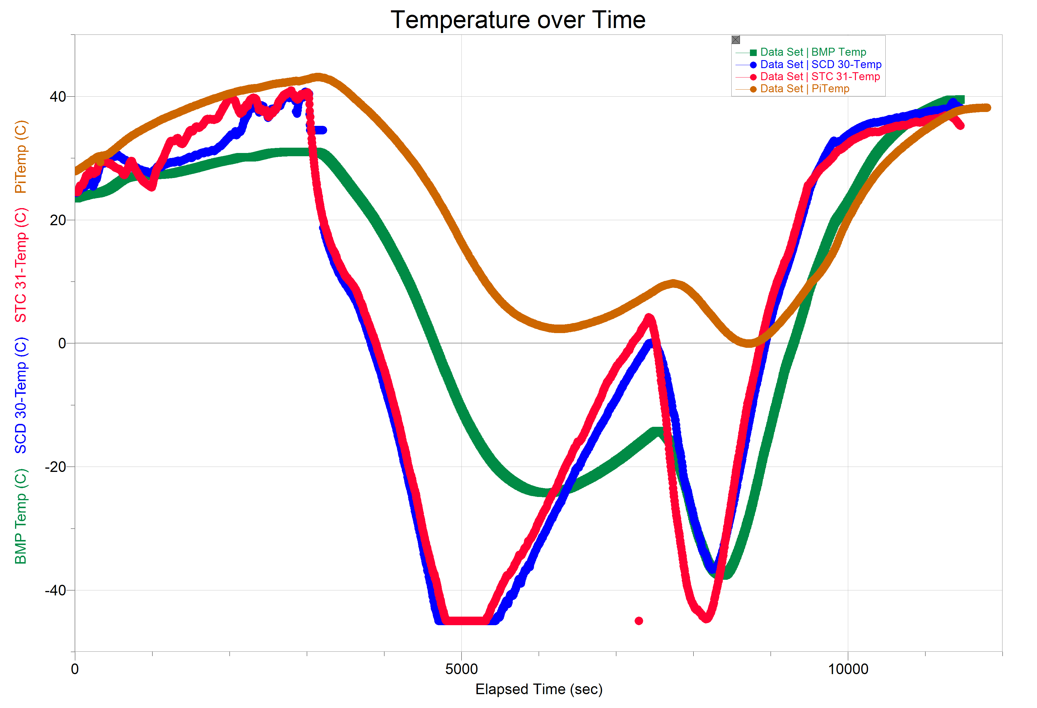
Temperature vs Time (William)
External sensors similar (Red & Blue)
Internal Sensors
Similar pattern
Pi (Orange) is hotter than Arduino (Green)
Pi Foam box is probably insulated better, holds heat
Inside sensors have a time delay to register temperature
Goes through Cold region on the way up, again on the way down
Between 12,000-17,000 meters altitude
Falls faster, so second dip is narrower
Land
Launch
Burst
Cold Zone

Slide 10
Summary (Michael)
Both payloads successfully flew without damage and recorded data.
Arduino CO₂ sensor worked. Resulting data matched the literature, showing a constant ppm relative to altitude.
The cold temperature range was between 12,000 and 17,000 meters. Coldest external temperature was around –50 C.
The % Relative Humidity also stays relatively constant around 22% with significant fluctuations.
UVA and UVB intensity increased as expected.
Ozone sensor did not work.
Altitude and pressure readings were consistent, and consistent with the ANSR readings. The Pi and Arduino had identical Altitude readings.

Slide 11
CONCLUSION (JD)
Further work is needed on the CO2 sensor for the Pi.
Further experimentation using the Pi would improve data collection. Using a newer model could also help.
We cannot draw a conclusion to the question we originally asked because the data we found is predominantly available for these measurements at ground level, not at higher altitudes.
We need to investigate further.
Improve mechanical design for better physical and electrical performance.

Slide 12

Collaboration with Diné College
Payload will carry biological experiments designed by DinÉ College

Slide 13
Special Thanks
Arizona Near Space Research
Michelle Coe
Diné College
Science & Engineering Division at Central Arizona College

Slide 14

Q & A

Slide 15
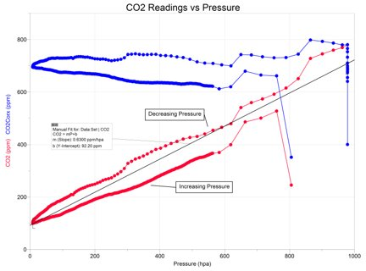
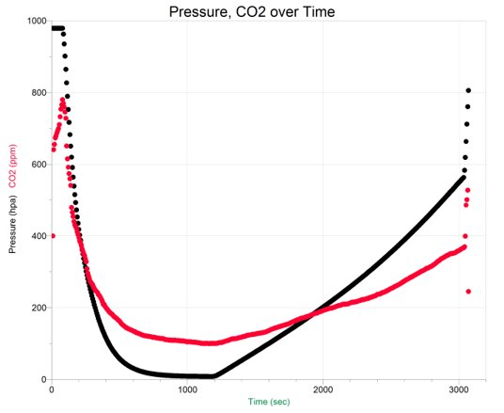

Slide 16
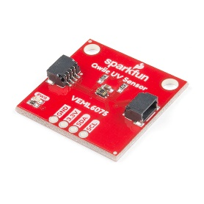
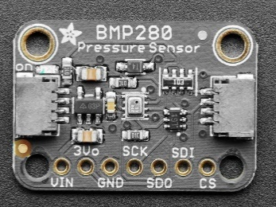
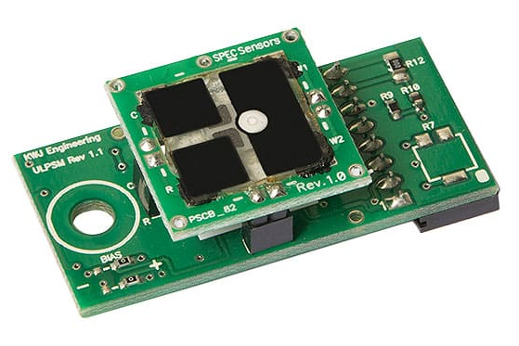
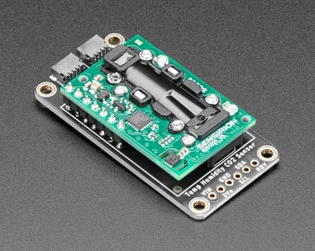
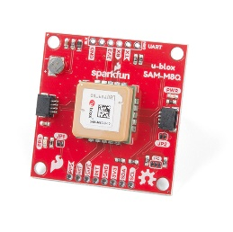
Project Sensors (Michael & Alex)
UV intensity (W/m²) is measured with a VEML6075 sensor.
Water vapor, Pressure, and internal box temperature are measured with a BMP388 sensor.
CO2 (ppm) is measured with an SCD30 sensor
Altitude, latitude, and longitude are measured with a u-blox SMA-M8Q GPS sensor
(Arduino) CO₂ (ppm)a STC31 sensor . These sensors also provide external temperature and humidity data.
(Arduino) Ozone concentration (ppm) is measured using Sensiron 968-046 sensor.
(Arduino) 9V Battery Voltage is measured with an ADC and a voltage divider.
*these are used on both payloads

Slide 17
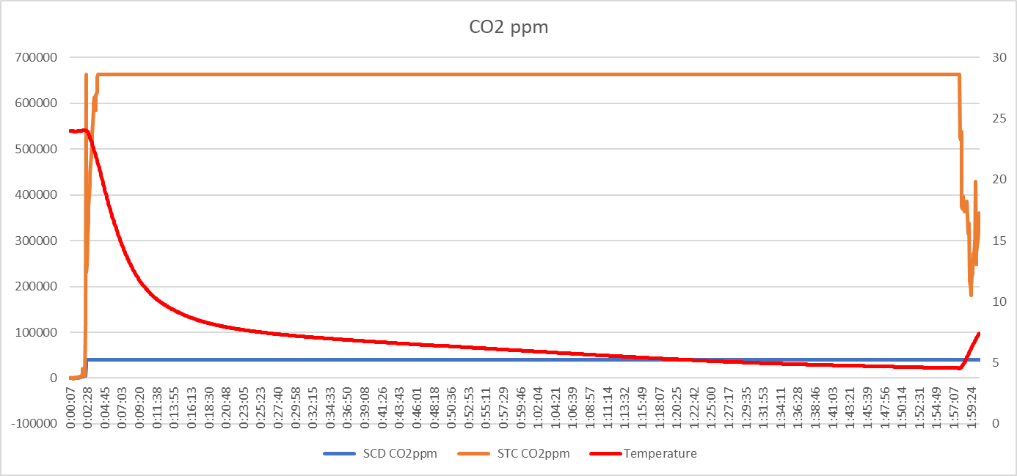
Cold Test (William)
At higher altitudes, air becomes thinner, which leads to lower temperatures.
To ensure systems, sensors and batteries will function in these harsh conditions.
Cooler filled with dry ice. The two setups are placed inside the cooler. The cooler is closed and sealed using duct tape. The system ran for 2 hours.
The sensors showed steady values with no variation or failure due to the cold temperature.

Slide 18
Vacuum Test (Brew)
Jacqueline Do graciously obtained access to a vacuum chamber at ASU.
Placed payload in chamber, ran pressure down to 7 mbar, then back up to normal pressure.
Question 1 – will sensors/computer run at low (~1 mbar) pressure?
Sensors gave data all the way down.
Question 2 - What do the gas readings mean?
1 atm 400 ppm
0.25 atm - ?? ppm

Slide 19
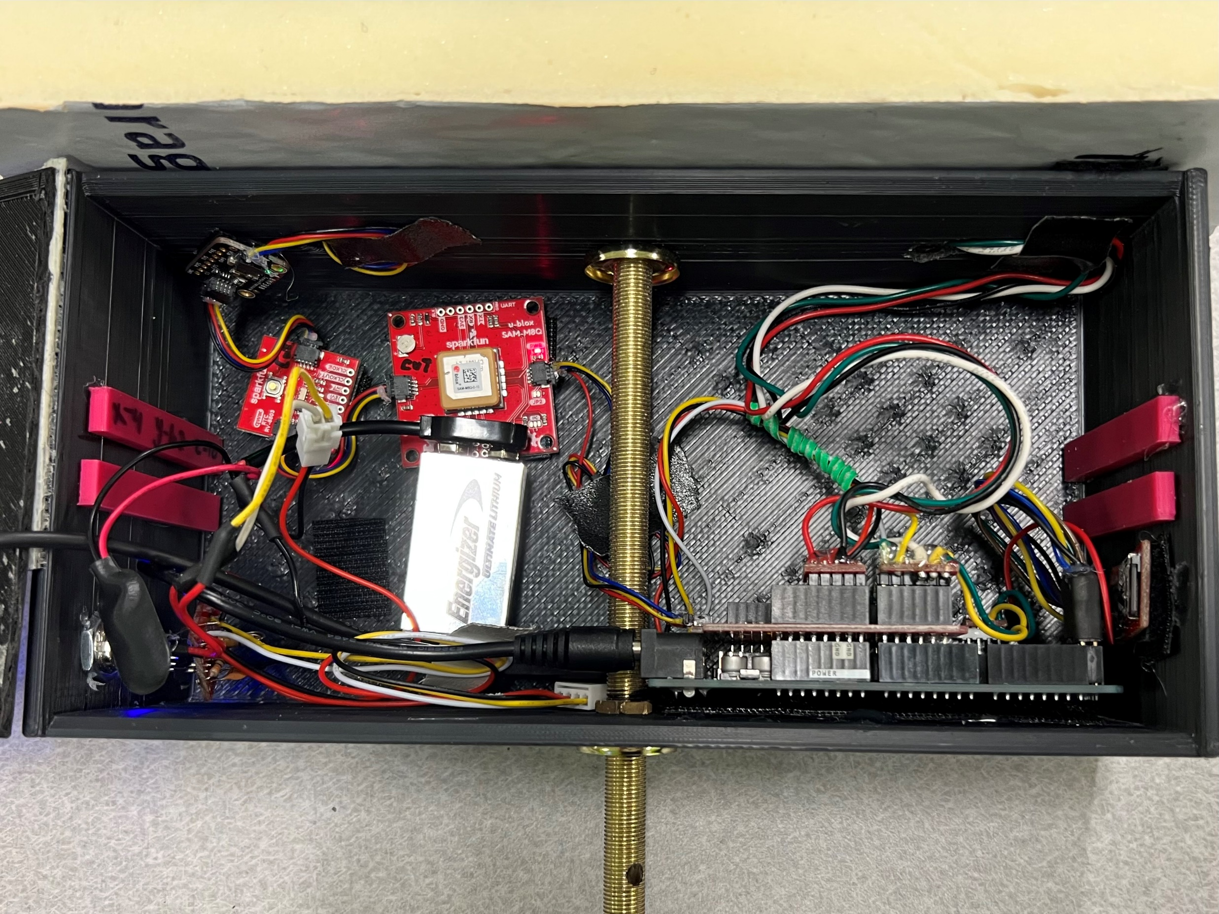
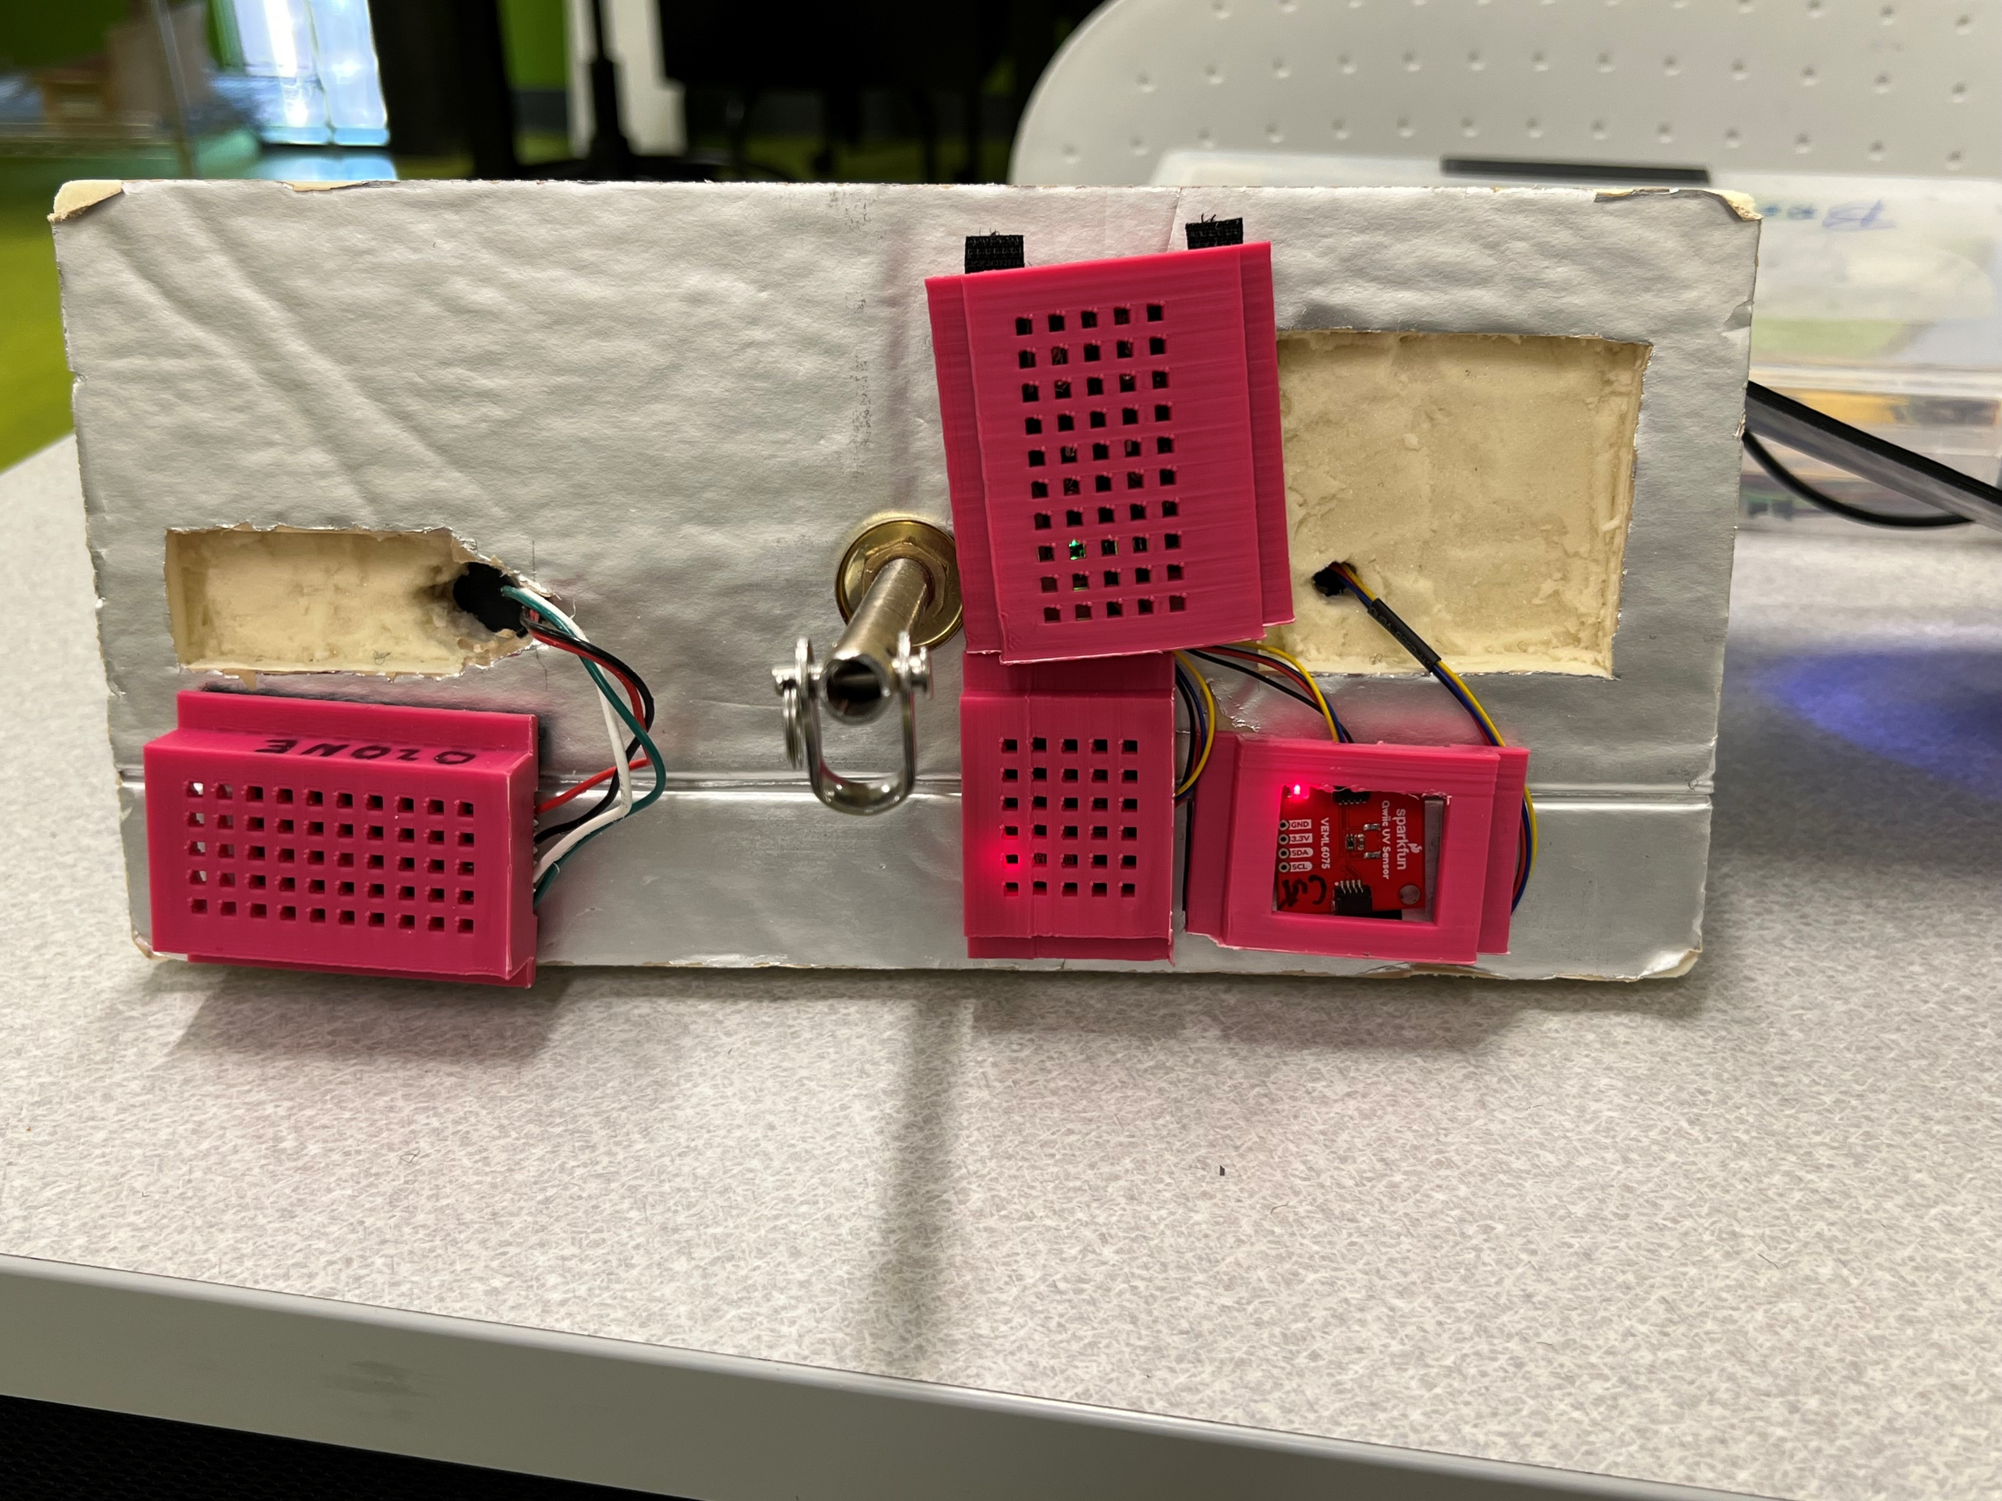
Two Systems (JD & Brew)
Raspberry Pi
All new Code and Hardware
Microprocessor based mini-computer
Linux OS allows more flexibility in programming
Sensor manufacturers develop python libraries to support the hardware
Built-in memory system simplifies logging
Arduino
Light weight, lighter 9V batteries (2)
Supports ADC
Supports all sensors in standard Arduino IDE
Most of the code already done
C++ Object oriented sensor and logging classes
Most sensors are I2C

